Slide 1


ELECTRICAL HEATING AND CONTROL OF RAILWAY SWITCHES

Slide 2

NEW GENERATION
ELECTRICAL HEATING AND CONTROL OF RAILWAY SWITCHES
REDUCTION OF ENERGY CONSUMPTION
PREVENTION OF EXCESSIVE HEATING
  AUTONOMOUS FUNCTIONALITY AND SAFETY OF OPERATION
  REMOTE MONITORING
  AND SERVICE
saving 26%
✓
The system is set so that the use of energy energy is as economical as possible = lower operating costs
Integrating weather forecasting together with smart sensors gives the system the ability to react earlier and more meaningfully
The combination of multi-stage sensors, machine learning and monitoring guarantees trouble-free operation
Remote control
Status monitoring
Ensuring service

Slide 3

FEATURES AND FUNCTIONALITIES OF THE SYSTEM
Multiple sensors
  Local weather forecast
Calculation of dew point
Data monitoring and analysis
Multi-faceted heating control
Cold and hot rail sensor
Precipitation sensor Thermometer
Humidity meter
Increasing the efficiency of heating control based on expected conditions
Autonomous monitoring and assessment services
Fault archiving
Automatic
Manual
Testing
The heating system works with the dew point value
Innovative operation algorithm
Regulation of the maximum consumption
Multiple communication
Full autonomy of operation
Switch control with possible extension
Remote control
Integration with 3rd systems
API | Modbus
Email | SMS
Meteorological profiles
for heating
User change of algorithm
Support for heating control within the technical maximum regulation
Operation without maintenance and local management
Public lighting
Person detection
Notes:
Nastavení prahových hodnot pro varování a pro kritické alarmy
Odhalení neefektivního fungování zařízení (nadměrná spotřeba zařízení, časté spínání zařízení, nerovnoměrné vícefázové zatížení,…)
-> prevence proti poruchám zařízení

Slide 4
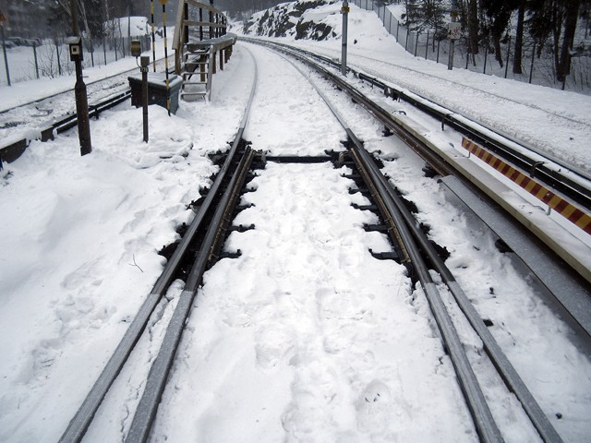
PRODUCT DESCRIPTION
The new generation presents a sophisticated solution for heating and controlling railway switches. This device is designed with an emphasis on energy efficiency, through an advanced algorithm and a unique combination of used sensory elements. Each solution is custom designed to meet specific requirements in the private or public segment of rail transport.
KEY PROPERTIES
Multi-faceted heating control: The system provides three heating control modes – automatic, manual and test. The automatic mode is optimized for maximum energy efficiency, the manual mode allows the user to start heating according to the current need for up to 60 minutes, while the test mode ensures an easy check of the functionality of the entire system, including self-test functions.
Sensors: Each track switch is equipped with two temperature sensors to obtain the reference and current temperature of the railway track. The system also includes its own precipitation sensor, thermometer and humidity meter for comprehensive monitoring of the environment.
Local weather forecast: Weather forecast increases the efficiency of heating control based on expected conditions.
Communication: Flexible remote communication options through a secure interface API or or through standard industry communication protocols.
Notes:
Nastavení prahových hodnot pro varování a pro kritické alarmy
Odhalení neefektivního fungování zařízení (nadměrná spotřeba zařízení, časté spínání zařízení, nerovnoměrné vícefázové zatížení,…)
-> prevence proti poruchám zařízení

Slide 5
HEATING REGULATORY SYSTEM
The control system consists of a precipitation sensor, a cold rail temperature sensor, a heated rail temperature sensor, a humidity and air temperature sensor, and a control unit, including a terminal communication device. The control system ensures automatic control, while the degree of automaticity directly depends on the climatic conditions of the given place.
Climate sensors (precipitation sensor and temperature and humidity sensor) indicate rain, snowfall and dew point value. In combination with the local weather forecast, the control system is able to appropriately choose the degree of heating and thus reduce the energy consumption of the system. Climatic condition sensors are placed in such a way that the sensed values correspond to the real condition in the space of the heated switches.
The cold rail temperature sensor is located at a sufficiently far distance from the heated switch so that its values are not affected by heating. Thanks to this sensor, it is possible to accurately determine the temperature of the rail outside of heating. The temperature sensor of the heated rail is located at the rod of the heated turnout in such a way as to ensure the transfer of heat to the sensor and to limit its cooling outside of contact with the rail.
The control unit can be placed in the LV switchboard or in a separate cabinet.
Notes:
Nastavení prahových hodnot pro varování a pro kritické alarmy
Odhalení neefektivního fungování zařízení (nadměrná spotřeba zařízení, časté spínání zařízení, nerovnoměrné vícefázové zatížení,…)
-> prevence proti poruchám zařízení

Slide 6
DATA MONITORING AND ANALYSIS
Fault monitoring system: When a fault occurs, such as a sensor failure, the system automatically detects the problem and informs the user. The state of the heating circuit is regularly monitored and any errors are clearly indicated.
Datalogger: This tool regularly collects and stores data about system performance and health, making it easy to monitor and analyze its function.
External screen: The system can be expanded with an external screen (integrated into the switchboard or located in the station building) that displays current data and allows logged-in users to change modes, parameters and view the book.
HEATING CABLES
Heating cables from Türk & Hillinger type RKW are used. RKW type flat tube heaters are suitable for all types of railway profiles and consist of a RKF-24 type flat heater and a waterproof junction box.
The number and power of heating cables is determined by the type of switch and local climatic conditions.
The power cables for the heating cables are routed from the low voltage switchboard to the individual switches by means of cables to junction boxes on the tracks located in close proximity to the switches. Cables then come out of these cabinets directly to the individual heating cables.
Notes:
Nastavení prahových hodnot pro varování a pro kritické alarmy
Odhalení neefektivního fungování zařízení (nadměrná spotřeba zařízení, časté spínání zařízení, nerovnoměrné vícefázové zatížení,…)
-> prevence proti poruchám zařízení

Slide 7
SELECTION OF POWER SUPPLY
The heating medium is electrical energy. The power supply can be implemented from different power levels. Standard solutions include power supply from the traction line AC 25kV 50Hz or power supply from the local distribution network with a voltage of 400V AC.
CONNECTION BOXES AND DISTRIBUTION LV
Connection boxes are made of durable plastic that is resistant to mechanical damage. They meet the standards of devices with class II protection and their protection reaches the degree of protection IP 65.
The low voltage (LV) switchgear complies with Class II protection equipment standards and provides IP 44/20 protection level. Its location may be on a separate pedestal within the track or it may be located in a separate building such as a transformer station.
The electrical supply is protected by a fuse switch in the function of the main switch. The switchboard contains an electricity meter used to measure energy consumption, but also to check the functionality of the heating elements of the circuit. Three outlets are added for each replacement – one for each of the struts and one for heating the tie rod. Each outlet is equipped with a circuit breaker, a contactor and a combined current protector. In addition, there is a control unit (PLC) in the switchboard, which includes communicating with superior systems or third-party systems. The switchboard can be equipped with a control screen for control option or the location of the screen can be chosen in the adjacent transport office / railway station.
Notes:
Nastavení prahových hodnot pro varování a pro kritické alarmy
Odhalení neefektivního fungování zařízení (nadměrná spotřeba zařízení, časté spínání zařízení, nerovnoměrné vícefázové zatížení,…)
-> prevence proti poruchám zařízení

Slide 8
INNOVATIVE SMART CONTROL SYSTEM
The system is equipped with an advanced control system that includes three heating modes. These allow users to adapt to different needs:
The automatic mode dynamically evaluates external conditions and, based on this information, adjusts the degree of heating in order to achieve optimal energy efficiency. At the same time, the automatic mode is adapted for driving within the technical maximum.
Manual mode allows users to directly control the system when automatic mode is insufficient or inoperative
The test mode provides an easy and efficient method to check the functionality of the entire system, allowing for quick detection and resolution of any problems. The test mode is also used for self-testing of system components.
Flexible algorithm settings: Users have the option to adjust the parameters of the heating algorithm to achieve the best possible performance in the given conditions.
For graphical display, remote control, access to the fault archive, the system can also be expanded with an output monitoring and control unit. This will also allow you to clearly monitor the status of individual parts of the system, such as the current status of each sensor, adjust temperature thresholds, etc. Thanks to the possibility of keeping a book of changes in this system, it is also possible to find each mode change and the data that the user made this change.
Notes:
Nastavení prahových hodnot pro varování a pro kritické alarmy
Odhalení neefektivního fungování zařízení (nadměrná spotřeba zařízení, časté spínání zařízení, nerovnoměrné vícefázové zatížení,…)
-> prevence proti poruchám zařízení

Slide 9
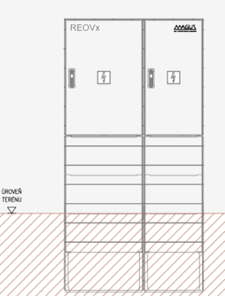
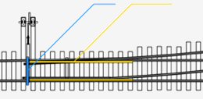







BLOCK DIAGRAM OF THE SYSTEM
Heating
circuits
rail 1
rail 2
Communication with the
parent system
Heating
circuit
rod
Regulatory system
Control unit (PLC)
Power part MaR
Power supply AC
3x400V or AC 25kV
MX
MX
MX
Ground
level
Switch sensors for regulation
General sensors for regulation
Weather
forecast
Hot rail sensor
Cold rail sensor
Outdoor temperature sensor
Precipitation sensor
Local weather forecast
Outdoor humidity sensor
Located at each heated switch
Located near the LV switchboard
Power supply cables
Outputs to switches
Notes:
Nastavení prahových hodnot pro varování a pro kritické alarmy
Odhalení neefektivního fungování zařízení (nadměrná spotřeba zařízení, časté spínání zařízení, nerovnoměrné vícefázové zatížení,…)
-> prevence proti poruchám zařízení

Slide 10

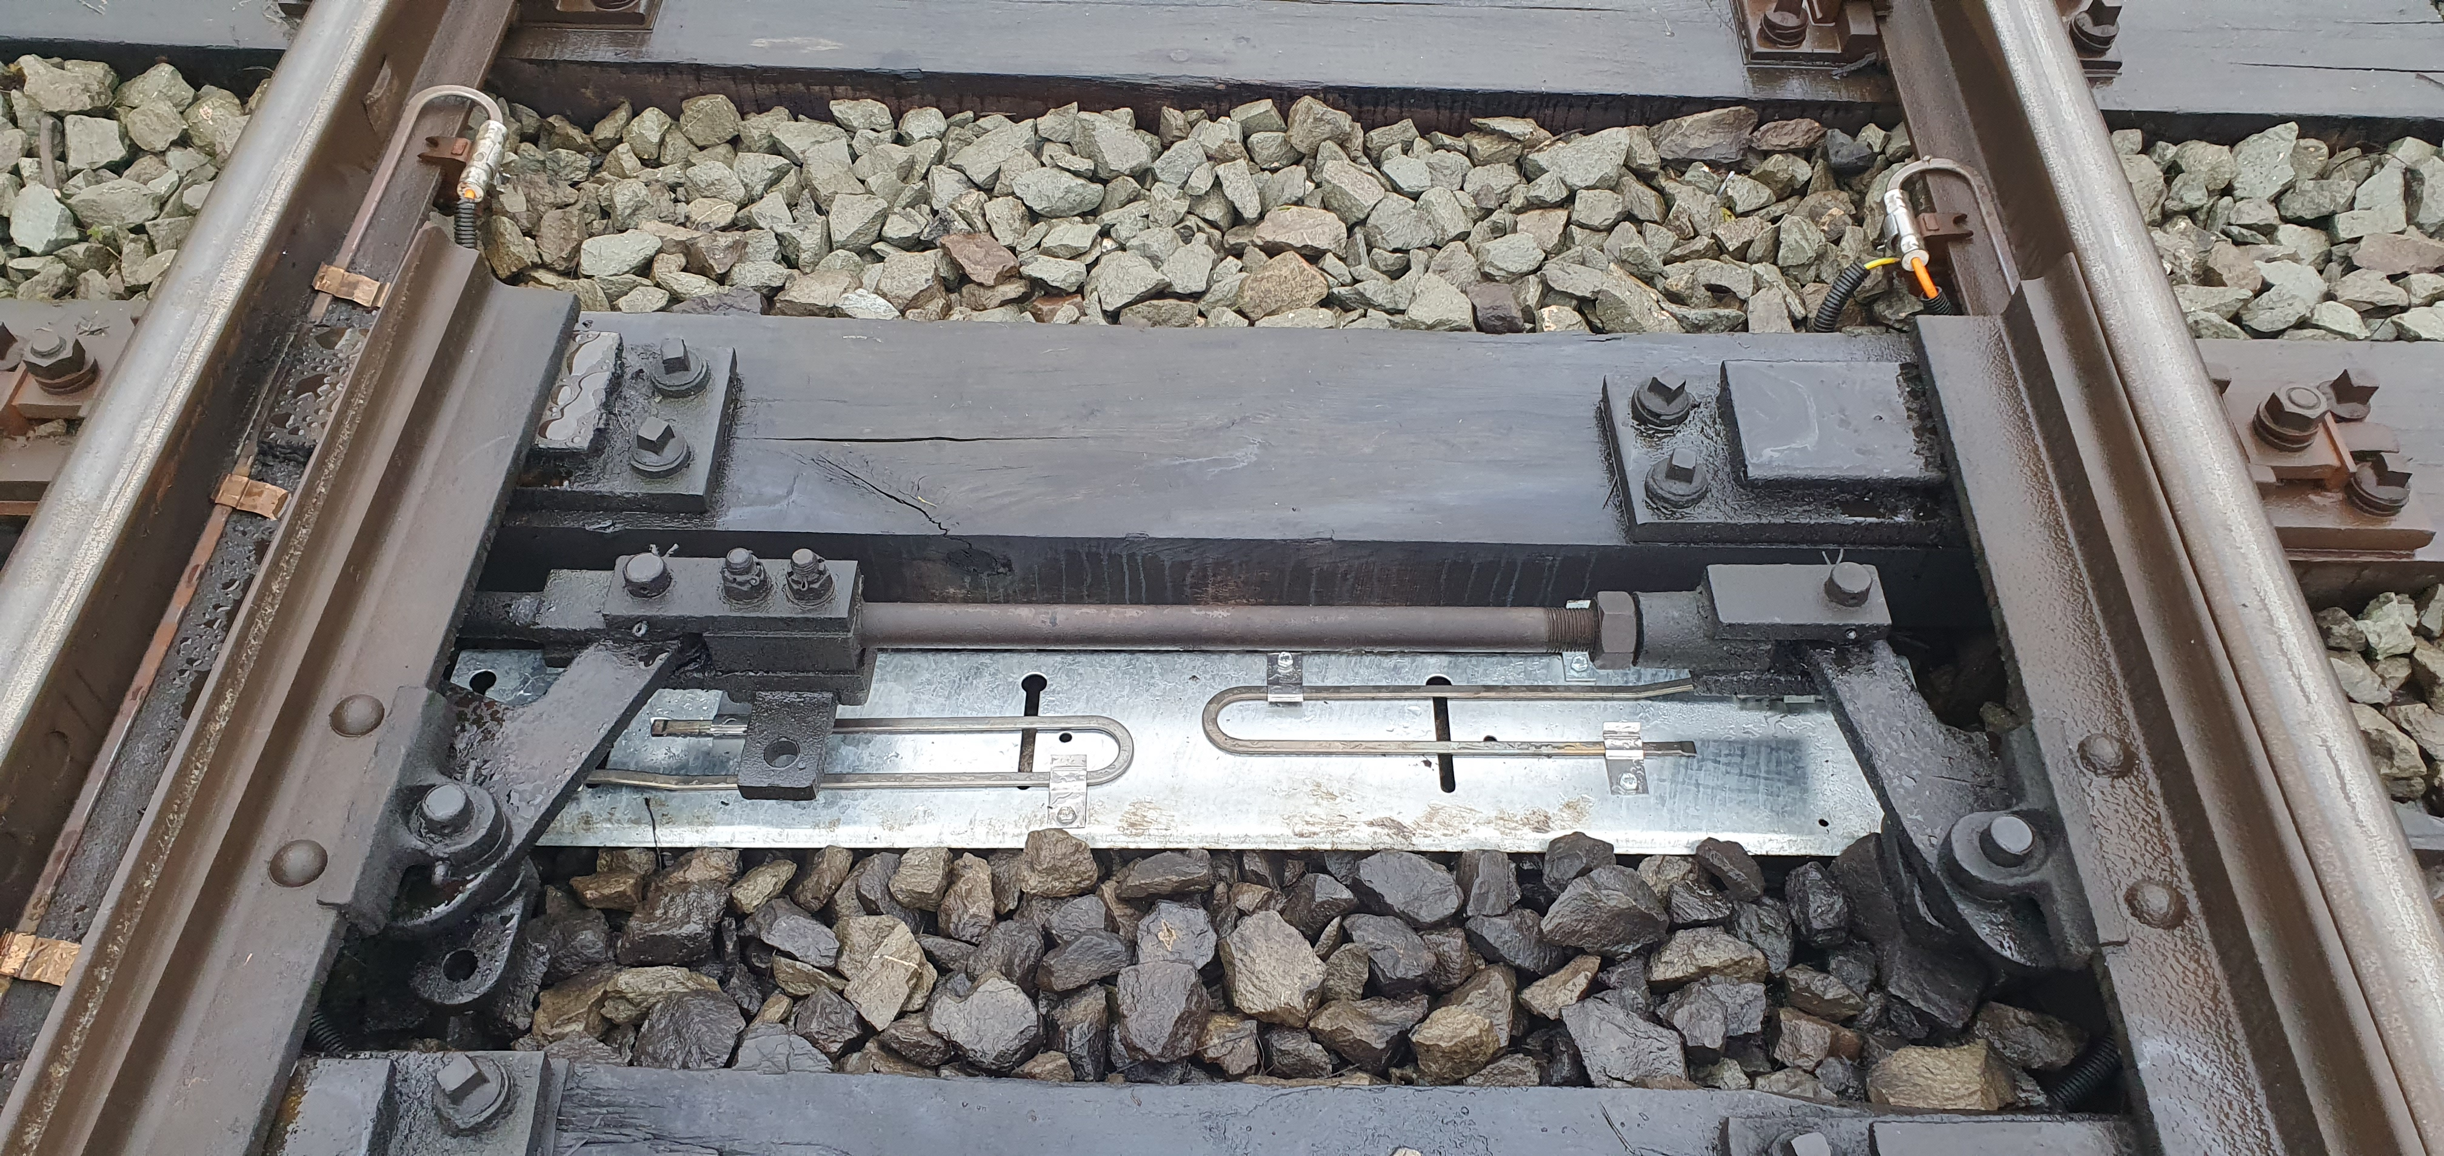
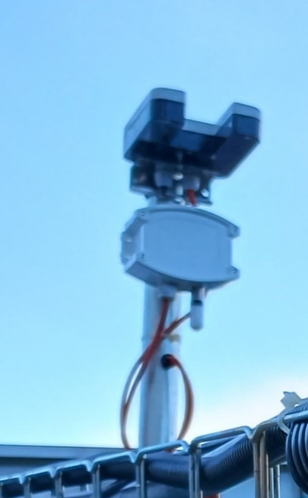
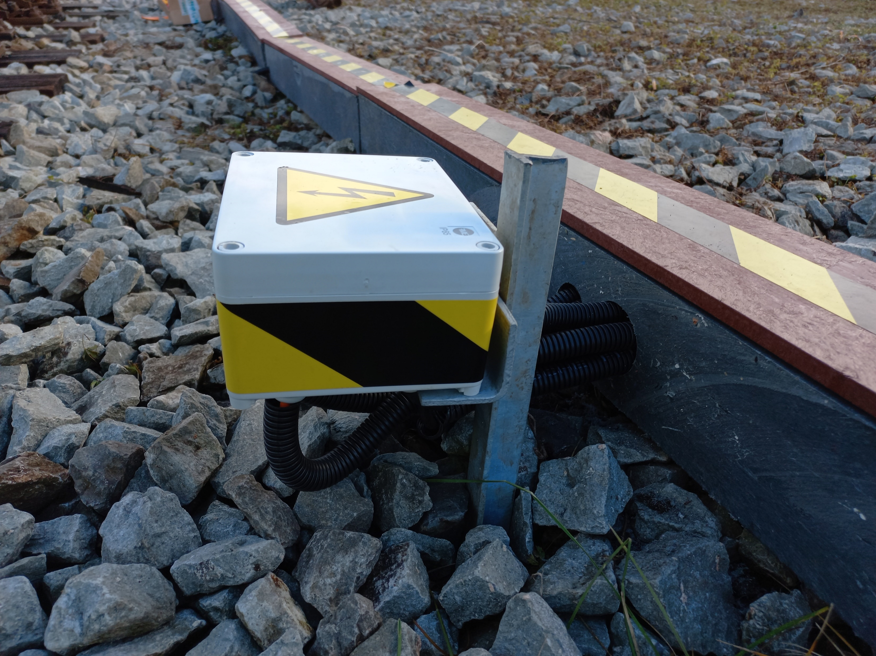
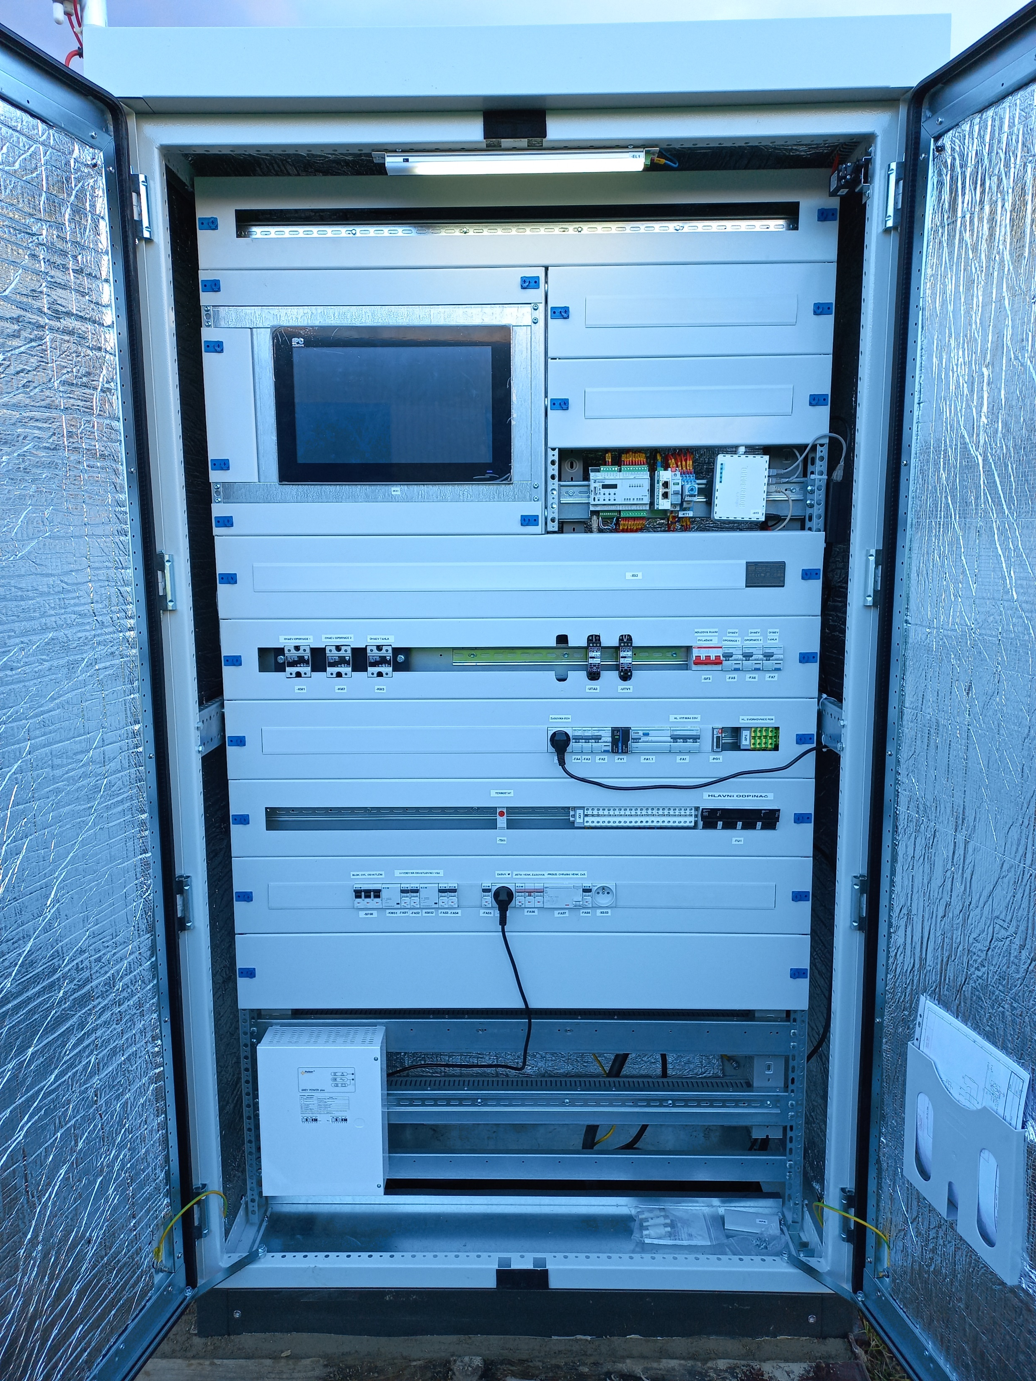
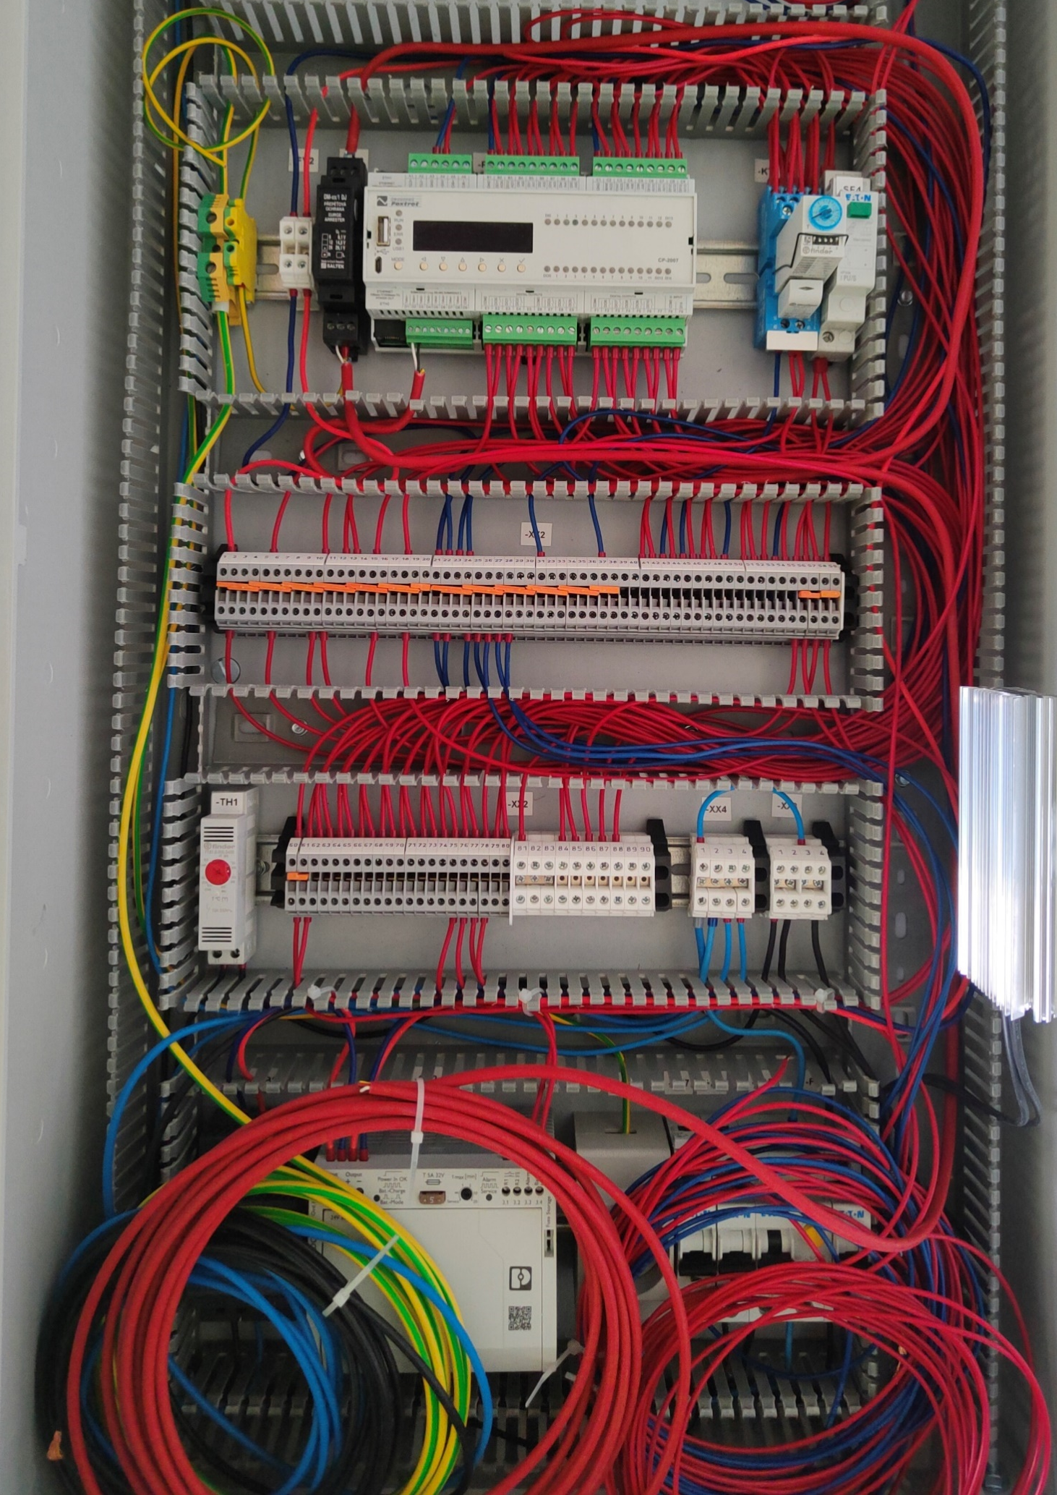
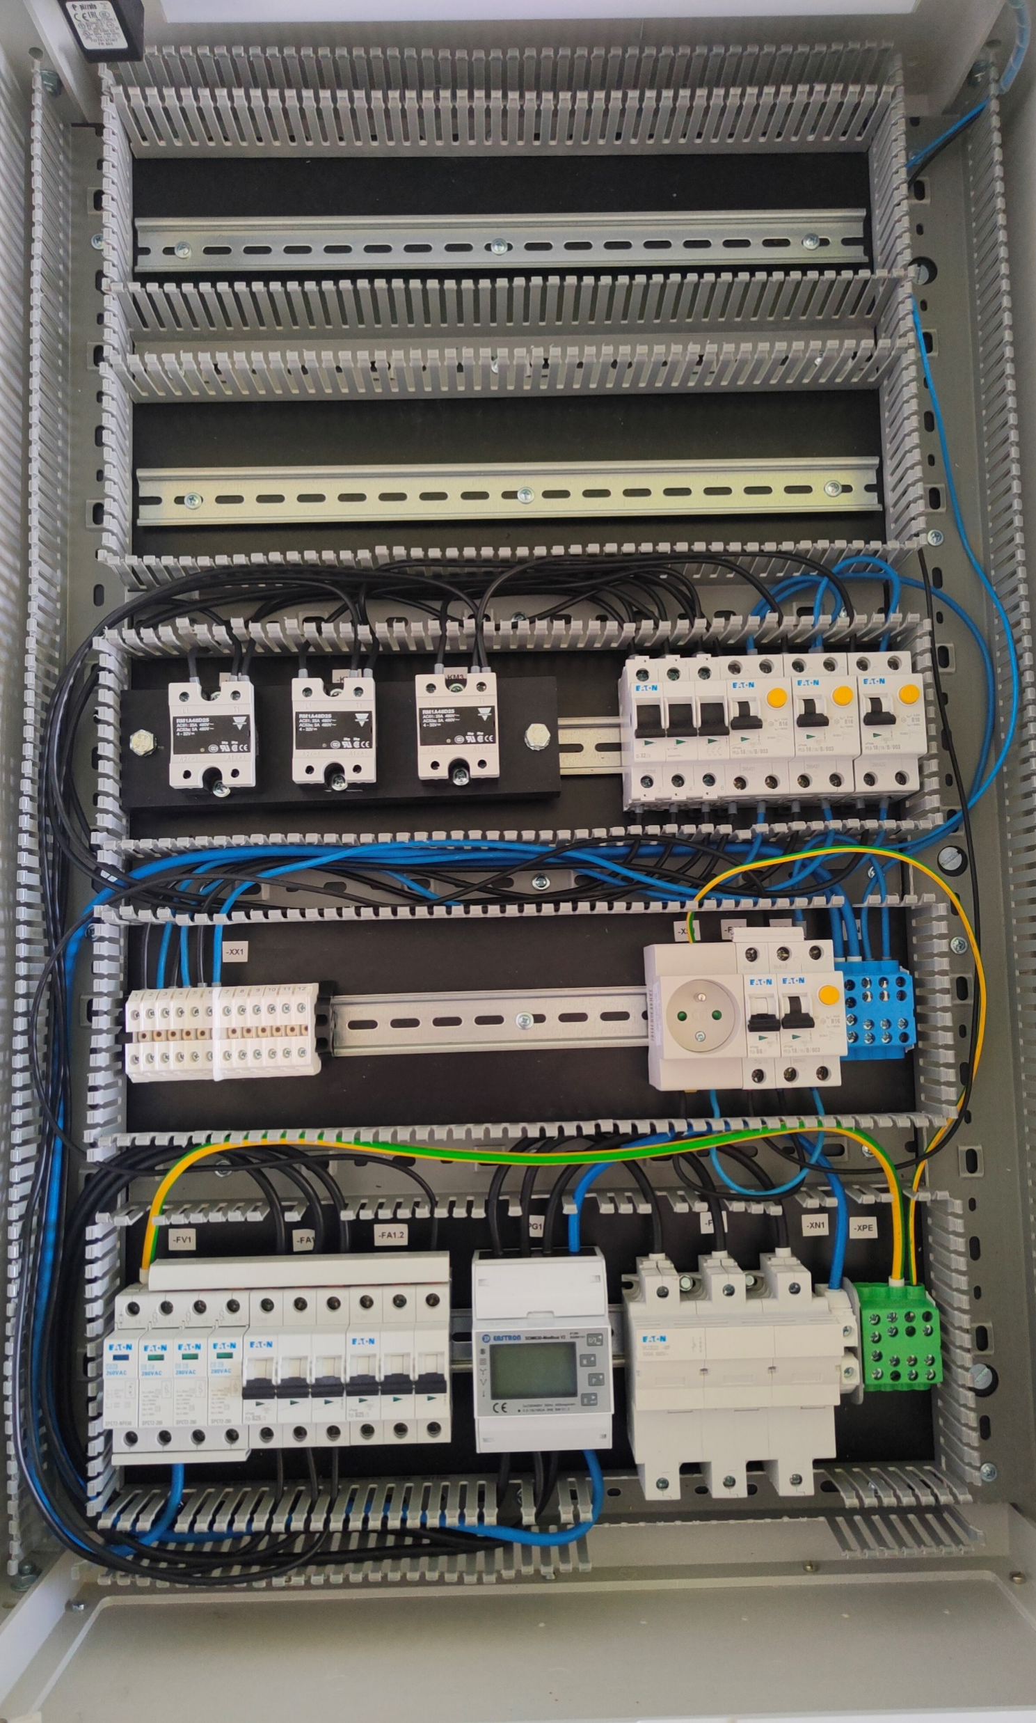
THE SYSTEM IS CREATED WITH THE FOLLOWING
COMPONENTS
Transformation station (in case of power supply from the traction line)
LV switchboard, control switchboard
Connection boxes near the adapter and the outlet of the heating rods of the supports
Connection boxes for the output of power cables to individual heating cables
Sensor of air temperature, precipitation, Humidity meter
Cold and heated rail temperature sensor
Smart electricity meter
Heating rods and wiring
Regulatory system
  control unit
  terminal communication device with security
Touch control panel, cameras (optional)
Notes:
Nastavení prahových hodnot pro varování a pro kritické alarmy
Odhalení neefektivního fungování zařízení (nadměrná spotřeba zařízení, časté spínání zařízení, nerovnoměrné vícefázové zatížení,…)
-> prevence proti poruchám zařízení

Slide 11
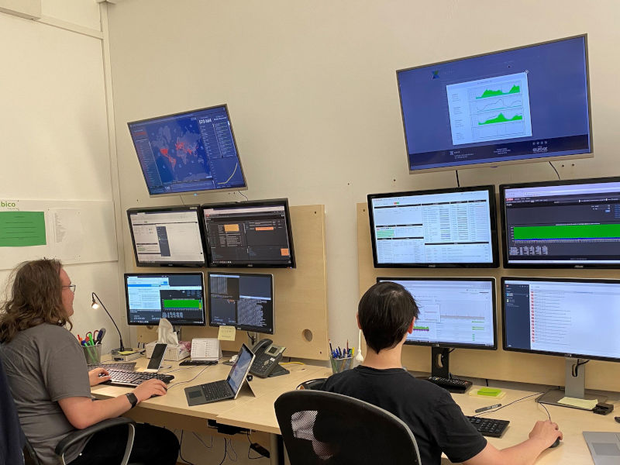
REMOTE MONITORING AND SERVICE
This is a service that ensures remote supervision and operation of the system via a data connection via the Internet. System monitoring takes place independently of the operator and enables continuous monitoring or control of the system. Remote monitoring and servicing can be obtained separately or as part of a service / partnership agreement.
Basic service parameters:
Monitoring 24 hours / 7 days a week
The service center is immediately informed of any event
Periodic sending of device status statements
A number of alarm causes can be solved remotely by our technician without visiting the end customer
The system is constantly under the control of the supervisory center
Notes:
Nastavení prahových hodnot pro varování a pro kritické alarmy
Odhalení neefektivního fungování zařízení (nadměrná spotřeba zařízení, časté spínání zařízení, nerovnoměrné vícefázové zatížení,…)
-> prevence proti poruchám zařízení

Slide 12
MAGUS INTERANTIONAL a.s.
Zvonařka 92/5
617 00 Brno
Czech Republic
Tel.: +420 602 731 056
rail@magus.cz
www.magus.cz
We are market leaders in the provision of innovative solutions and the development of new technologies for the use of data in transport, the development and production of control and management technologies for railways, transformer technology, electric heating of exchanges, cable distribution, substations and power systems including storage.
We have rich references, professional experience and can thus offer stable quality of our services at a high level.
We build long-term relationships with our customers based on professionalism and mutual trust.

